Slide 1
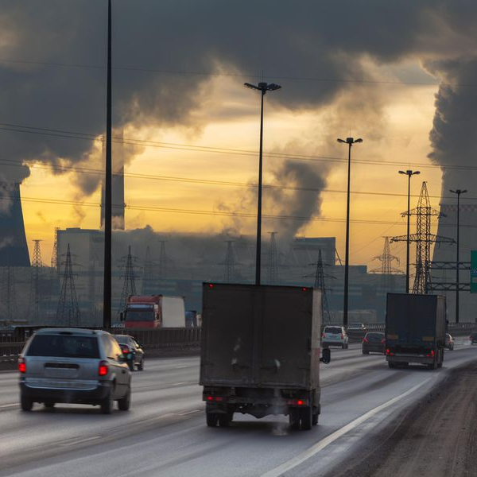
Measuring Air
Quality:
Background & introduction to the practical
Grant Allen &
DoĞuŞhan KiliÇ

Slide 2
Outline
Introduction to the Practical Course (G12)
Forming of the research teams (G12)
Setting up the Hand-held monitors (G12)
Collecting meteorological data at Brunswick Park
Data check (Back to G12!)

Slide 3
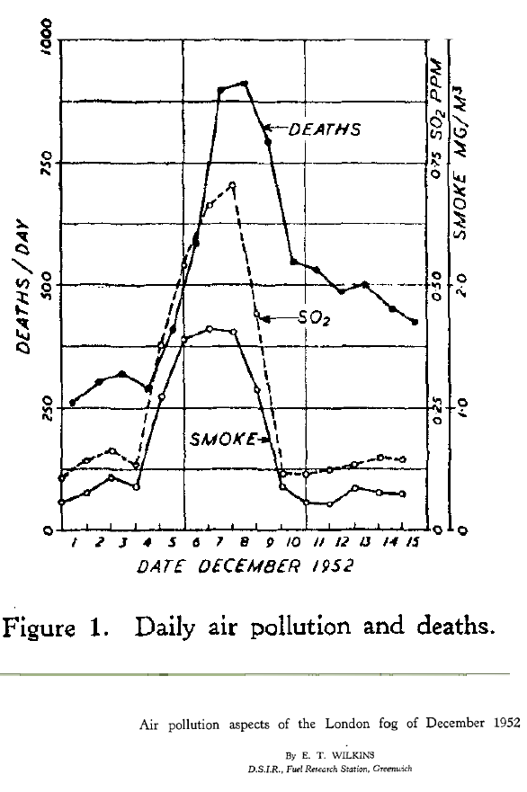
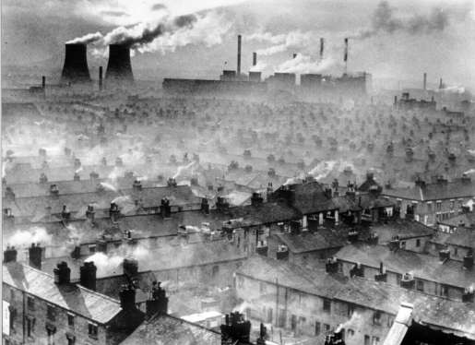
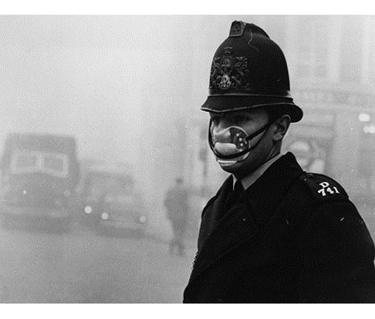
AIR POLLUTION: AN overview
London’s Great Smog of 1952:
  Coal burning (domestic/industrial heating) anticyclonic conditions
  Thousands of deaths
  Anti-pollution legislation - “Clean Air Act” (1956)
Notes:
The London Smog, also known as the Great Smog of 1952, was a severe air pollution event that affected London mostly from December 5 to December 9, 1952. Due to a combination of cold weather, windless conditions, and the burning of large amounts of coal, a dense layer of smoke and fog formed hanging over the city.
Cause: The smog was primarily a result of burning low-quality coal in homes and power stations under windless conditions. The pollutants from the coal burning, including particulate matter, soot and sulphur dioxide mixed with water vapor in the atmosphere, creating a thick, toxic fog.
Impacts: The smog severely reduced visibility and penetrated homes, affecting respiratory health. It is estimated to have caused between 4,000 and 12,000 deaths due to respiratory illnesses like bronchitis and pneumonia.
The smog led to major disruptions in transportation, halting railways, air traffic, and even ambulances. It also harmed livestock and wildlife.
The London Smog highlighted the dangers of air pollution, leading to increased public awareness and eventually prompting the Clean Air Act of 1956 in the UK. This act regulated the burning of coal and led to a reduction in air pollution through the introduction of "smoke control areas" and restrictions on the use of coal in urban areas.
The event is often cited as a pivotal moment in environmental and public health policy, showing the deadly effects of air pollution.

Slide 4
Developments in transport, industry, etc. – changes in pollutant emissions
Main pollutants of current concern:
  Nitrogen Oxides (NO_{x})
  Particulate Matter (PM)
  Ozone (O₃)
Pollutant | Sources | Health Impacts | Environmental Impacts
NO_{x} PM O₃ | Fossil fuel combustion (transportation, industry) Lightning Soils Fossil fuel combustion (transportation, industry) Agriculture Sea-spray, dust & ash Secondary pollutant – reaction of NO_{x} and volatile organic compounds (VOCs) in the presence of sunlight | Respiratory impacts Cardiovascular impacts Respiratory impacts Respiratory impacts Worsening of pre-existing respiratory illnesses | Acid rain – damage to ecosystems (e.g. forests, lakes) Smog formation over towns and cities Reduced visibility (formation of hazes) Can act as carriers for certain pathogens and harmful substances Powerful oxidant – damage to vegetation & historical heritage, impacts crop yields Smog formation over towns and cities
Notes:
Currently, these pollutants are the major concern for public in cities.
Secondary pollutants form in the atmosphere via primary pollutants, can be gas or aerosol.

Slide 5
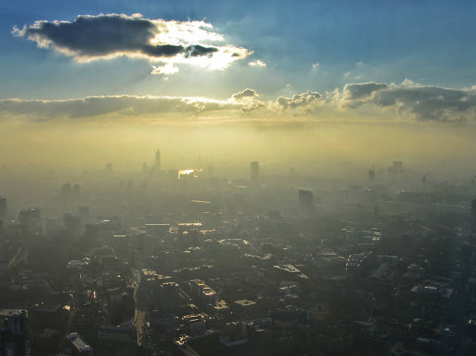
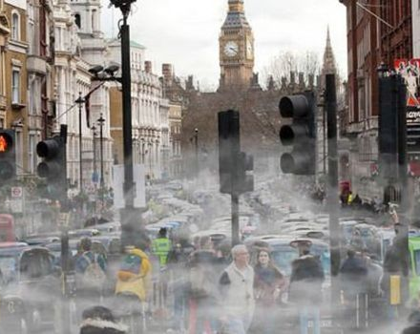
Air pollution is a global problem:
  7 million premature deaths in 2012
  One of the top 10 threats to global health in 2019 (WHO)
Largest environmental health stressor on UK population:
  40,000 premature deaths/year; £10-£20 billion/year
ACCURATE MEASUREMENT & MONITORING OF AIR POLLUTANTS IS EXTREMELY IMPORTANT
  Develop our understanding of processes and pollutants which are affecting air quality (shifts in vehicular and industrial technology, etc.)
  Major health and environmental impacts
  Assess the effectiveness of air quality intervention policies
Notes:
4 out of 7 million premature deaths due to indoor air pollution.

Slide 6
Atmospheric data:
measurement errors
This practical involves the measurement and interpretation of atmospheric data.
Measurements must be as accurate as possible, but we can never avoid errors and uncertainties in what we measure!
All measurements need to have error estimates so we know how confident we can be in our analysis and interpretation.
Three main types of errors:
  Systematic Random Representativity
Notes:
Human error and environmental impacts covered under “Representativity”.

Slide 7
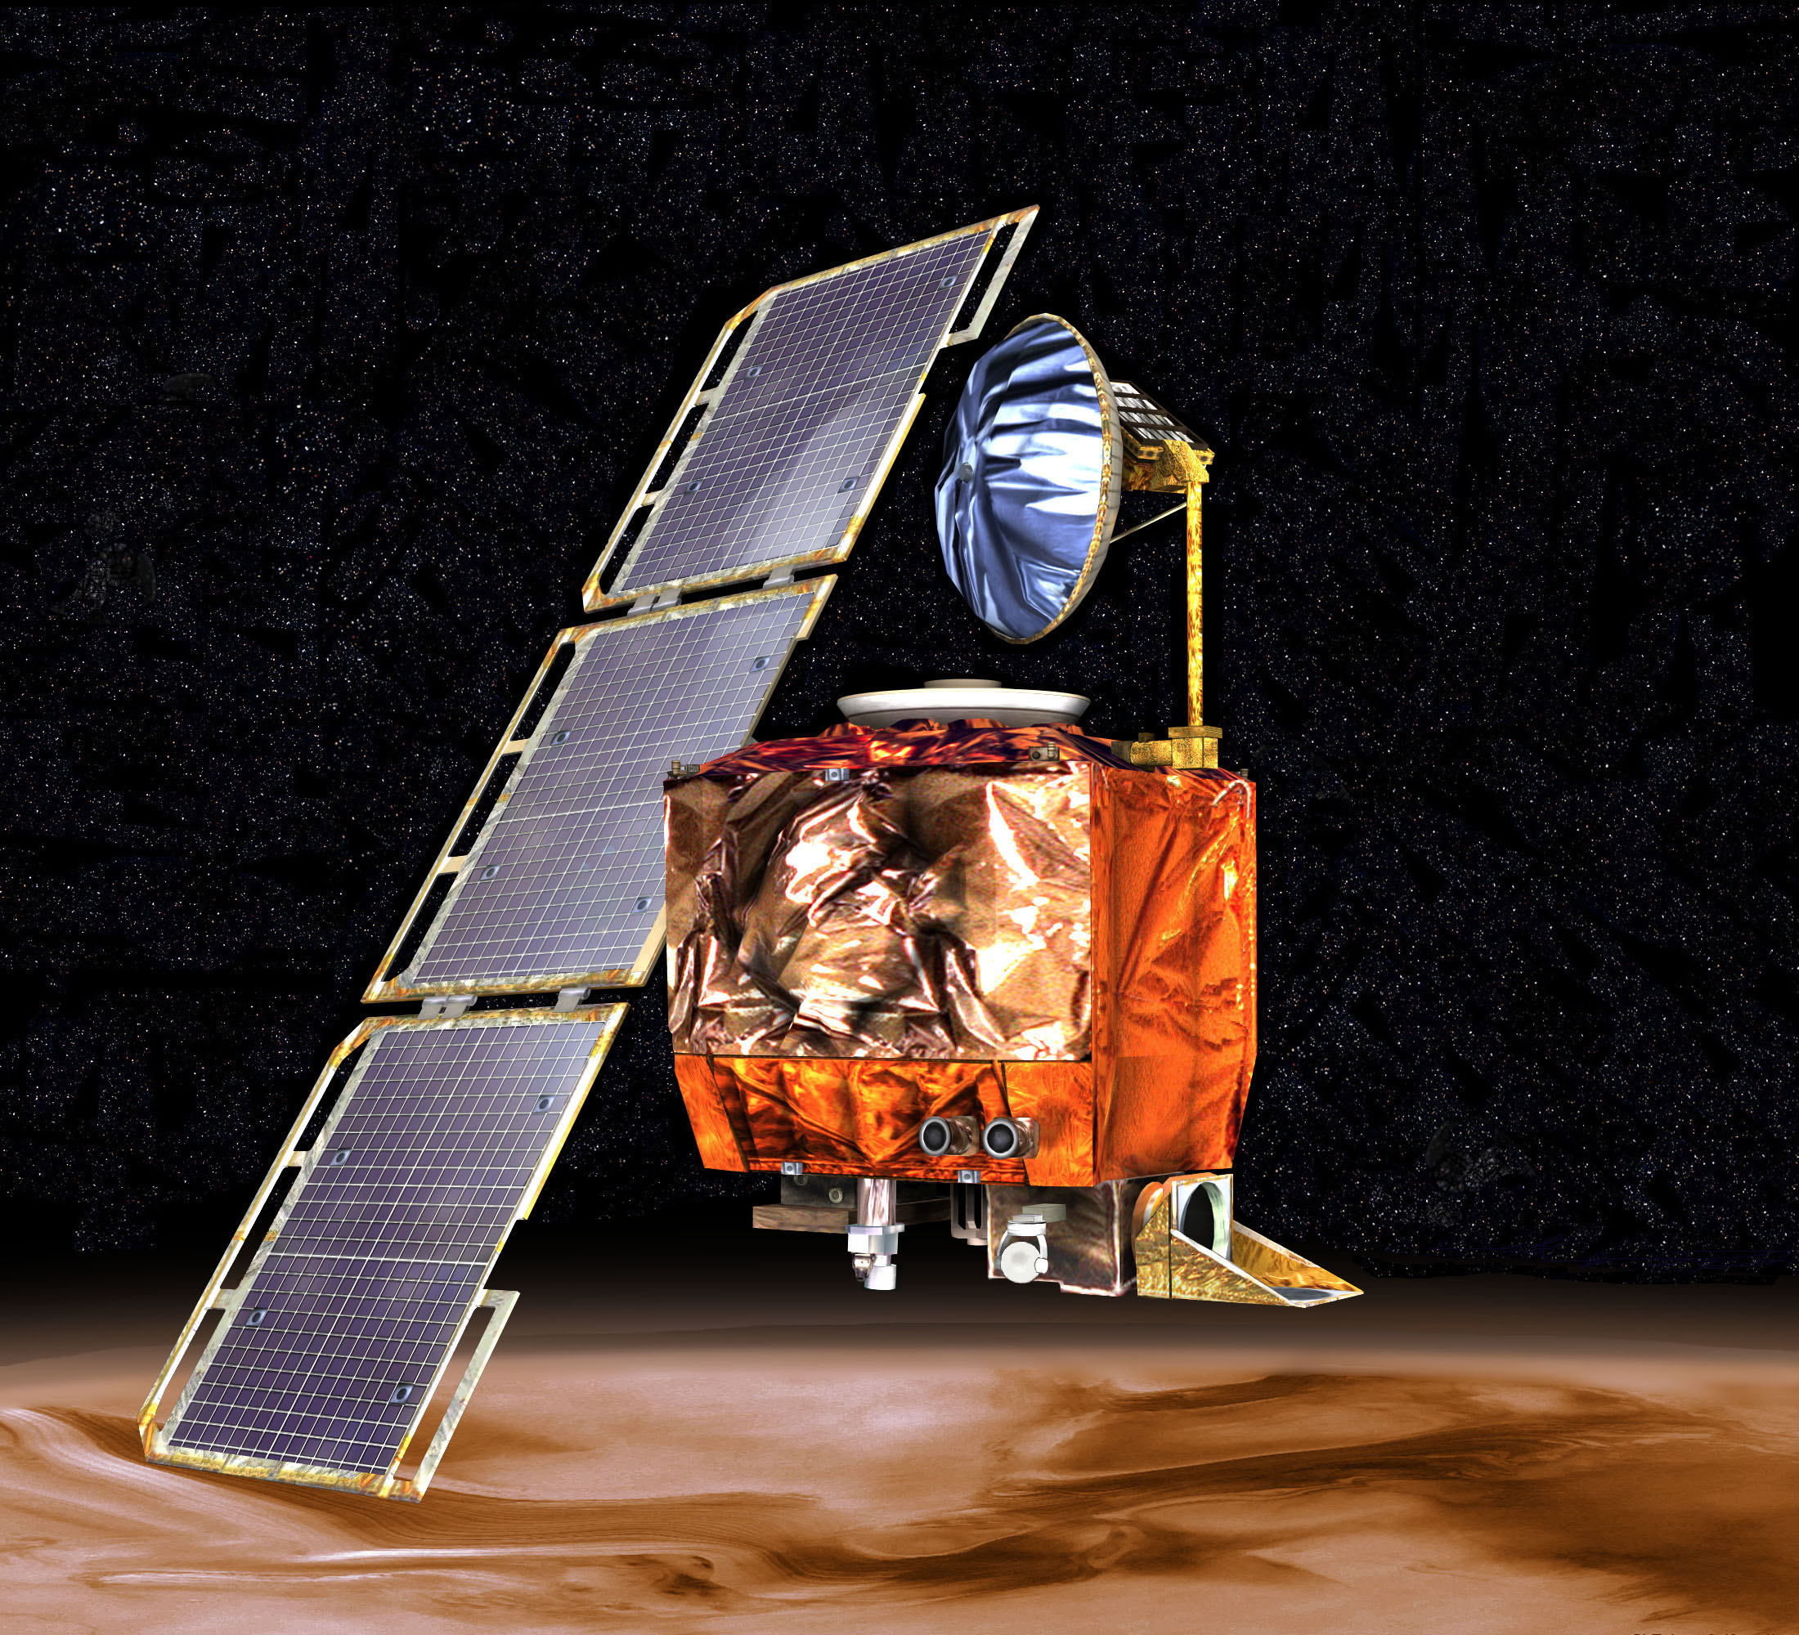
A Costly Error: NASA's Mars Climate Orbiter(1999)
In 1999, NASA's Mars Climate Orbiter was lost because of a unit conversion error. One team used the metric system (newton-seconds), while another used the imperial system (pound-seconds) to calculate the spacecraft's trajectory.
This led to the spacecraft entering Mars' atmosphere too low, causing it to burn up. The mission, which cost $125 million, was lost.
Even minor errors, if not caught, can have major impacts, underscoring the importance of attention to detail in all forms of data collection.
Notes:
Errors are part of the game but some of them can be costly!
……
Lesson & Relevance to Air Quality Monitoring: This demonstrates how seemingly small, errors in data handling or equipment settings can lead to large consequences. In air quality monitoring, miscalibrating equipment or using incorrect settings could lead to inaccurate pollution readings, affecting health guidelines or policy decisions.

Slide 8
Systematic errors
Reproducible errors which affect all your measurements in the same way
Typical causes:
  Observational error
  Imperfect instrument calibration
  Environmental interference
Notes:
Systematic errors are consistent, repeatable inaccuracies caused by flaws in measurement devices or methods.
Examples:
Instrument Calibration: Incorrectly calibrated sensors can give consistently biased readings.
Sensor Drift: Over time, air quality sensors may drift and need regular recalibration.
Long-term biases in data leading to incorrect conclusions about air quality trends.

Slide 9
Systematic errors: simple examples
1) Zero error
Forgetting to tare or zero a balance
Measurements will always be ”off” by the same amount
You have an offset
.
3) Instrument drift
Successive readings become consistently lower or higher over time
Can be a result of changing in meteorological conditions, such as temperature or humidity
2) Scale error
Device has not been calibrated properly
Correct through comparison with a standard

Slide 10
How to deal with
Systematic errors
Make sure instruments are corrected for zero off-sets
Regular calibrations of instruments
Comparing values against standards

Slide 11
RANDOM errors
Cause one measurement to differ slightly from the next
Caused by unpredictable changes during an experiment:
  Instrumental noise
  Real variations in what is being measured
Notes:
Random errors are unpredictable variations in measurement, often due to environmental factors or device limitations.
Examples:
Environmental Noise: Sudden temperature changes or humidity spikes can affect sensor readings.
Power Supply Fluctuations: Voltage fluctuations affecting the sensor’s performance.
Random errors increase uncertainty but can often be minimized through multiple measurements or statistical methods.

Slide 12
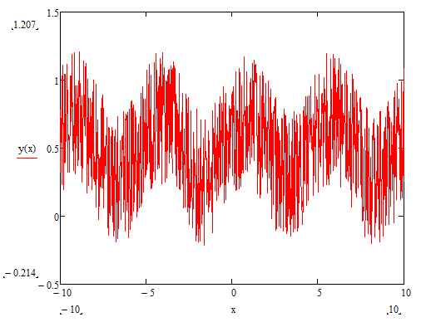
RANDOM errors:
A simple examplE
Random variations in signal – e.g. wind speed measurements
Measurements are noisy!
Wind speed measurements vary depending on factors such as altitude and time
Take multiple readings and average them to get representative conditions – gusts and changes in direction affect the instantaneous value.
.

Slide 13

Gaussian nature of
RanDOM ERRORS
Random errors are just as likely to move the measured value in either direction (positive or negative with respect to the mean)
They have what we call a normal Gaussian distribution - characterised by a mean and a standard deviation:
  Mean = “central” or average value Standard deviation = spread of data points around the mean
Normal distributions have an equal number of measurements above and below the mean value
Mean - 1 standard deviation
Mean
Mean + 1 standard deviation
Notes:
Law of large numbers: Increased number of samples will reduce the uncertainty in estimating mean (average) or the most likely out come of the population.

Slide 14
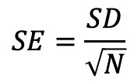



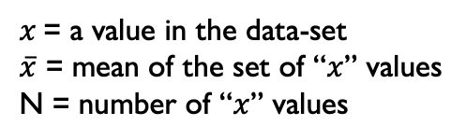
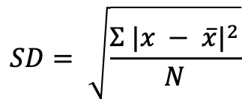

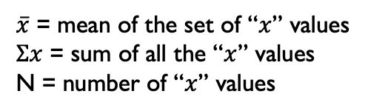
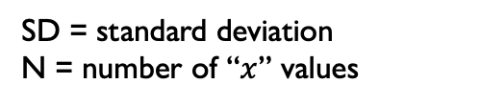
Estimation of RANDOM “NOISE” ERRORS
These errors are quantified by taking multiple measurements
$$x$$
$\overline{x}$ = mean of the set of “$x$” values
$Σx$ = sum of all the “$x$” values
N = number of “$x$” values
Mean:
$\overline{x}$ = $\frac{Σx}{N}$
$$x$$
$$SD= \sqrt{\frac{Σ {|x − \overline{x}|}^{2}}{N}}$$
$x$ = a value in the data-set
$\overline{x}$ = mean of the set of “$x$” values
N = number of “$x$” values
Standard Deviation:
$$x$$
Standard Error:
$$SE=\frac{SD}{\sqrt{N}}$$
SD = standard deviation
N = number of “$x$” values

Slide 15
How to deal with
RANDOM ERRORS
Random error ALWAYS occur
They can’t be predicted (but they can be measured)
To measure the random error, we can take many data points (typically >100) and average them.
This will quantify random error and will help you to estimate the true mean value.

Slide 16
Representativity errors:
How to take a good measurement
These are very important for field measurements.
e.g. is the wind measured at a point the same as that measured 100 metres away?
There will be several factors which could affect your measurements. You will need to take these into account when analysing your data, for example:
  Are you doing anything which could be affecting the measurements?
  Are there any external factors (e.g. in your surroundings) which could be having an impact?

Slide 17
THE PRACTICAL
PREPARATION:
You will group yourselves (6-8 people per group)
Collect your Kestrel and map from a member of staff.
  Your group will be given a letter “A, B, C, D, E, F”. This corresponds to your measurement location on the map.
Go to your measurement location with your group and assign roles
  Who will be responsible for the Kestrel?
  Who will connect the Kestrel to the “Kestrel LiNK” app on their phone?
  Who will be noting down measurements manually?
  Who will be taking note of the surrounding environment and conditions (buildings, winds, etc.)?

Slide 18
EXPERIMENT 1:
Measurements of meteorological parameters will be taken over a 25-minute period.
The Kestrel will automatically record temperature, pressure, relative humidity, wind direction and wind speed every second over the 25-minute period
  IF connected to the “Kestrel LiNK” app on your mobile
If your role is to manually record temperature, pressure, relative humidity this should be done every minute over the 25-minute period.
  This is important – it will mean that you have plenty of data points to use in your analysis, if there are technical issues with the Kestrel (automatic logging / data export)

Slide 19
EXPERIMENT 2:
There will be a high-quality research-grade standard (reference) weather station situated in Brunswick Park. This will be recording temperature, pressure and relative humidity over the same time period as your measurements.
  This data will be made available to you on Blackboard after the activity.
  You will use the data from this reference instrument after the practical to compare with your Kestrel data.

Slide 20
THE ASSIGNMENT
  Step 1: One member of each group should email their Kestrel data (as an Excel spreadsheet) to dogushan.kilic@manchester.ac.uk as soon as possible after the practical
  Step 2: Kestrel Data from one group and data from the reference weather station will be provided on Blackboard for you to analyse individually
  Step 3: You should calculate the mean and standard deviation for pressure, temperature and relative humidity recorded by both the Kestrel and the standard weather station.
  Step 4: You should calculate the difference between the data from the Kestrel and the weather station (this is called the calibration offset). This is calculated by subtracting the mean value of pressure, temperature and relative humidity measured by the Kestrel from the corresponding mean value of the weather station
  Step 5: Once you have these values, answer the questions in the online test on Blackboard.
  You will receive instant feedback on the answers to the questions in the online test. This does not count towards your degree mark (it is a formative exercise)

Slide 21
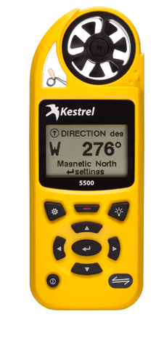
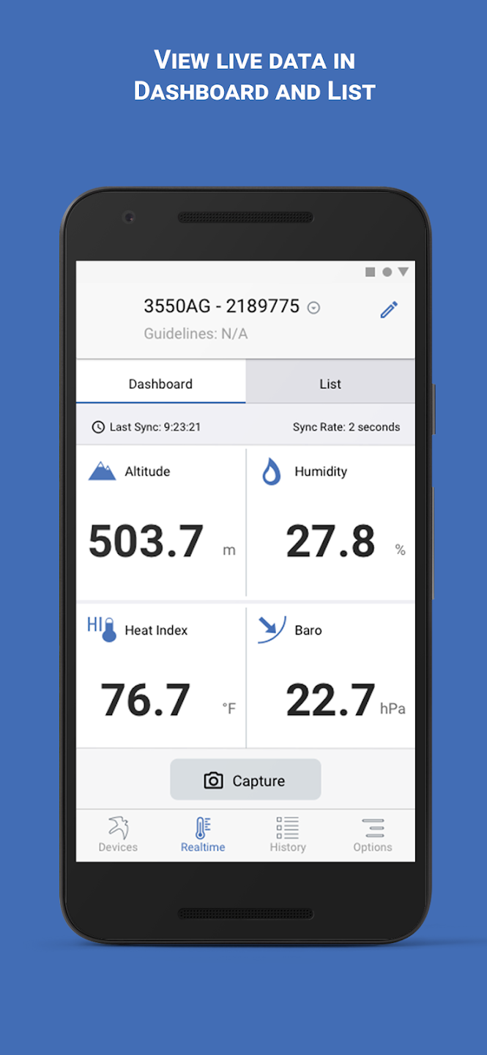

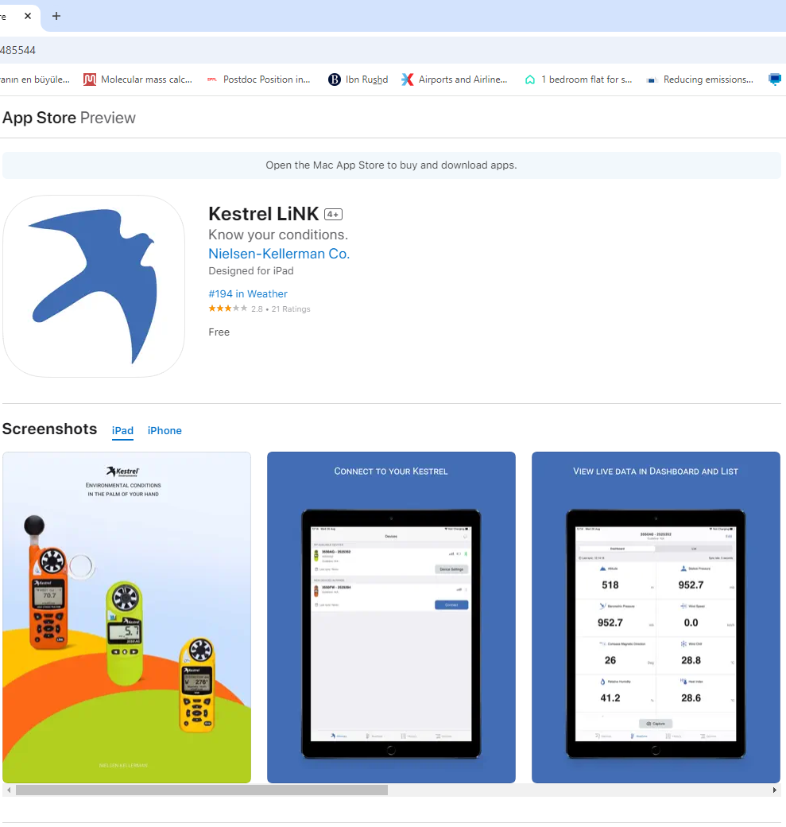
Kestrel link app

Slide 22
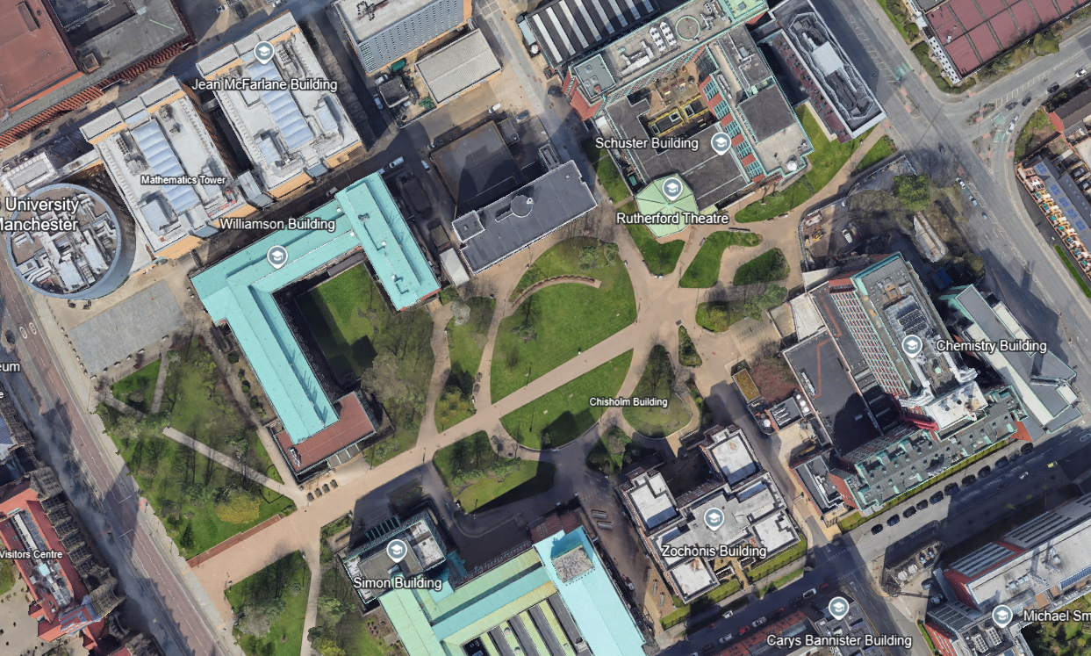
F
C
D
A
RS
B
E

